Slide 1




DIGITAL ELECTRONICS: ECE 213
Topic: Sequential Circuits, Latches and Flip flops
UNIT IV: Introduction to Sequential Circuits

Slide 2
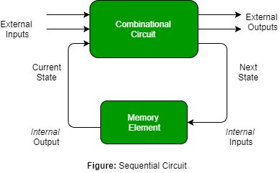
Introduction to Sequential Circuits
Sequential circuits are those in which the output depends not only on the present inputs, but also on the previous output state and/or the previous inputs.

Slide 3
Difference between Combinational and Sequential Circuits
Combinational Circuits | Sequential Circuits
The output depends only upon the present inputs | output depends not only on the present inputs, but also on the previous output state and/or the previous inputs
No feedback | Feedback available from output to input
No ability to store | Ability to store
Easier to design, use and handle | not easier to design, use and handle
No clock signal | Clock signals are required for triggering purposes
Faster | slower than combinational circuits
Elementary building block: Logic gates | Elementary building block: Flip flops
Examples: Adder, Subtractor, Magnitude comparator, Multiplexer, Decoder, etc. | Examples: Latches, flip flops, counters, registers,etc.

Slide 4
QUICK QUIZ (POLL)
Which of the following is NOT the combinational circuit?
magnitude comparator
multiplexer
parity generator circuit
Flip flop

Slide 5
Basic Storage Element: Latch
A storage element in a digital circuit can maintain a binary state indefinitely (as long as power is delivered to the circuit), until directed by an input signal to switch states.
Storage elements that operate with signal levels (rather than signal transitions) are referred to as latches; those controlled by a clock transition are flip-flops.
Because they are the building blocks of flip-flops, so, we will consider the fundamental storage mechanism used in latches before considering flip-flops.

Slide 6
What are latches.
A latch is a bistable multivibrator (exactly two stable states).
These states are high-output and low-output.
A latch has a feedback path, so information can be retained by the device.
Latches can be memory devices, and can store one bit of data for as long as the device is powered.
As the name suggests, latches are used to "latch onto" information and hold in place.
Latches are very similar to flip-flops, but are not synchronous devices, and do not operate on clock edges as flip-flops do.
Some various types of flip-flop circuits are as follows:
SR latch
Gated SR latch
D latch

Slide 7
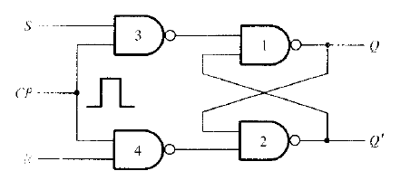
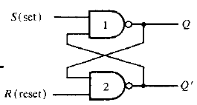
Difference between both….?
Latches.. Flip Flop..
Both are same but there is a little difference between both.
Latches are the building blocks of
sequential circuits.
latches can be built from gates.
latch does not have a clock signal.
flip-flops are also the building blocks of
sequential circuits.
Flip-flops can be built from latches.
A flip-flop always has a clock Signal

Slide 8
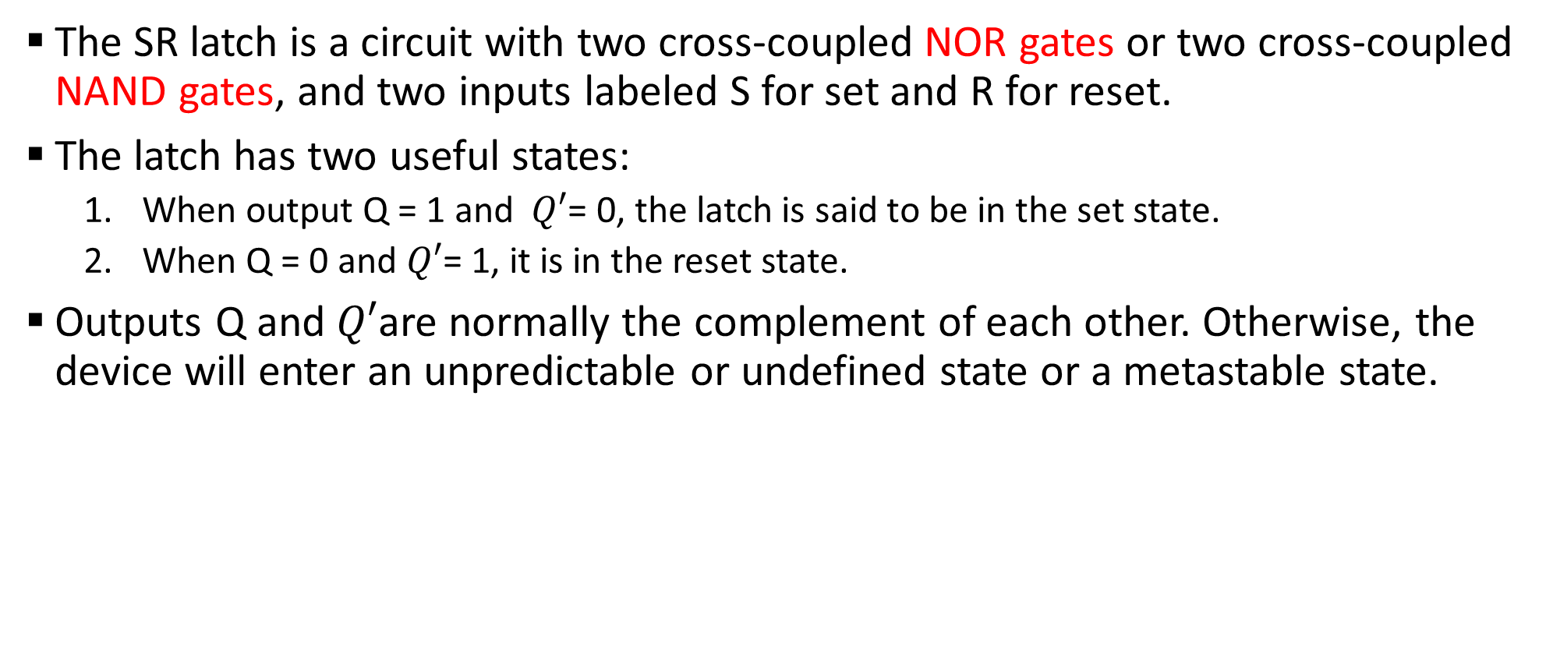
SR Latch
The SR latch is a circuit with two cross-coupled NOR gates or two cross-coupled NAND gates, and two inputs labeled S for set and R for reset.
The latch has two useful states:
When output Q = 1 and $Q′$= 0, the latch is said to be in the set state.
When Q = 0 and $Q′$= 1, it is in the reset state.
Outputs Q and $Q′$are normally the complement of each other. Otherwise, the device will enter an unpredictable or undefined state or a metastable state.

Slide 9

QUICK QUIZ (POLL)
What is the output state in SR latch at Q = 1 and $Q′$= 0
set
reset
memory
indeterminate

Slide 10
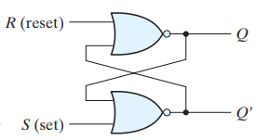
SR NOR Latch

Slide 11
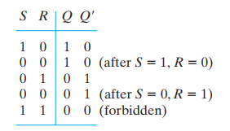
SR NOR Latch

Slide 12
QUICK QUIZ (POLL)
Which of the following state is invalid/indeterminate in SR NOR latch?
S=1, R= 0
S=0, R= 1
S=0, R= 0
S=1, R= 1

Slide 13
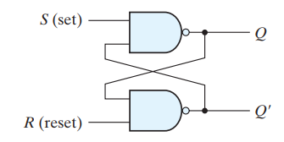
SR NAND Latch

Slide 14
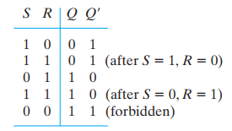
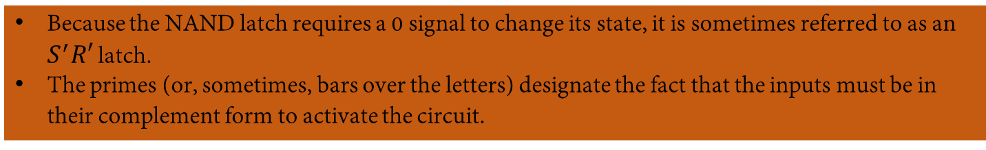
SR NAND Latch
Because the NAND latch requires a 0 signal to change its state, it is sometimes referred to as an $S^{′}R′$ latch.
The primes (or, sometimes, bars over the letters) designate the fact that the inputs must be in their complement form to activate the circuit.

Slide 15
QUICK QUIZ (POLL)
Which of the following state is invalid/indeterminate in SR NAND latch?
S=1, R= 0
S=0, R= 1
S=0, R= 0
S=1, R= 1

Slide 16
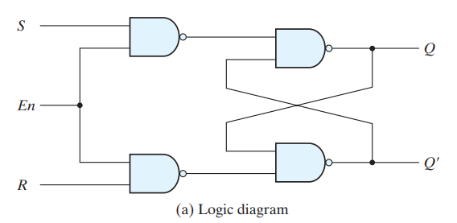
SR Latch with control input
The operation of the basic SR latch can be modified by providing an additional input signal that determines (controls) when the state of the latch can be changed by determining whether S and R can affect the circuit.

Slide 17
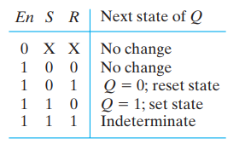
SR Latch with control input
The operation of the basic SR latch can be modified by providing an additional input signal that determines (controls) when the state of the latch can be changed by determining whether S and R can affect the circuit.

Slide 18
QUICK QUIZ (POLL)
What is the output state in SR enabled NAND based latch at S=1, R= 0, and En=0?
Q= set
Q=reset
Q=memory
Q=indeterminate

Slide 19
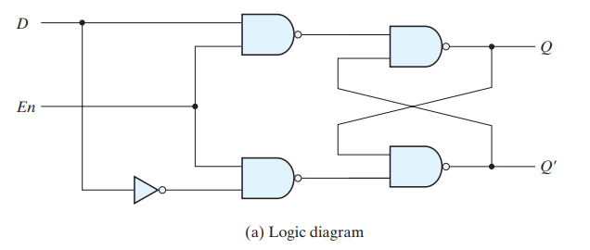
D Latch (Transparent Latch)
One way to eliminate the undesirable condition of the indeterminate state in the SR latch is to ensure that inputs S and R are never equal to 1 or 0 at the same time. This is done in the D latch.

Slide 20
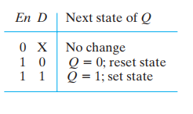
D Latch (Transparent Latch)
One way to eliminate the undesirable condition of the indeterminate state in the SR latch is to ensure that inputs S and R are never equal to 1 or 0 at the same time. This is done in the D latch.

Slide 21
D Latch (Transparent Latch)
The D latch receives that name from its ability to hold data in its internal storage. It is suited for use as a temporary storage.
The binary information present at the data input of the D latch is transferred to the Q output when the enable input is asserted.
The output follows changes in the data input as long as the enable input is asserted. This situation provides a path from input D to the output, and for this reason, the circuit is often called a transparent latch.
When the enable input signal is de-asserted, the binary information that was present at the data input at the time the transition occurred is retained (i.e., stored) at the Q output until the enable input is asserted again.

Slide 22
QUICK QUIZ (POLL)
In D flip-flop, D stands for _____________
a) Distant
b) Data
c) Desired
d) Delay

Slide 23
QUICK QUIZ (POLL)
When is a flip-flop said to be transparent?
When you can see through the IC packaging
When the Q output follows the input
When the Q output is opposite the input
None

Slide 24
QUICK QUIZ (POLL)
An active HIGH input S-R latch is formed by the cross-coupling of
Two NOR gates
Two NAND gates
Two OR gates
Two AND gates

